Slide 1
Divide and conquer 3 Linear time sorting
CS240 Spring 2024
Rui Fan

Slide 2
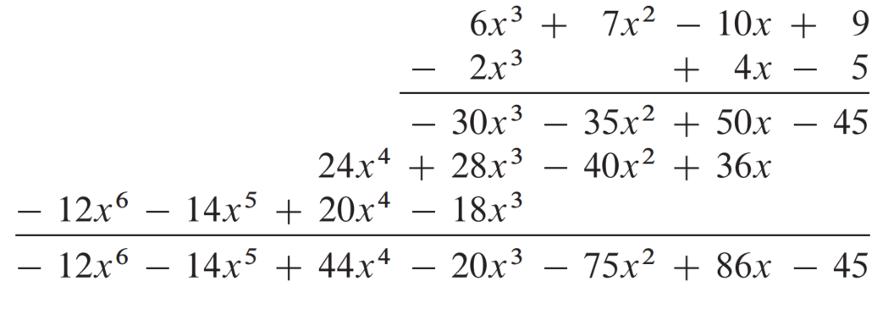

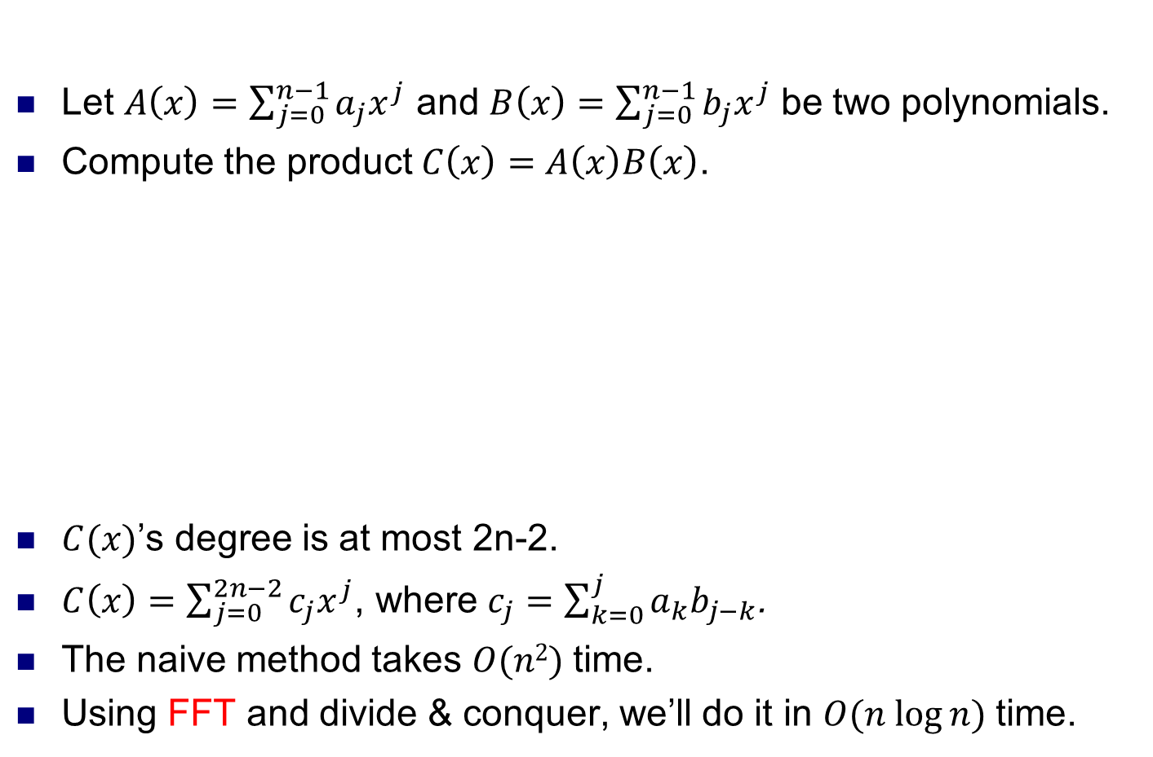

Polynomial multiplication
Let $A\left(x\right)=\sum_{j=0}^{n−1}{a_{j}x^{j}}$ and $B\left(x\right)=\sum_{j=0}^{n−1}{b_{j}x^{j}}$ be two polynomials.
Compute the product $C\left(x\right)=A\left(x\right)B\left(x\right)$.
$C(x)$’s degree is at most 2n-2.
$C\left(x\right)=\sum_{j=0}^{2n−2}{c_{j}x^{j}}$, where $c_{j}=\sum_{k=0}^{j}{a_{k}b_{j−k}}$.
The naive method takes $O(n2)$time.
Using FFT and divide & conquer, we’ll do it in $O(n log⁡n)$time.
$$A(x)$$
$$B(x)$$

Slide 3
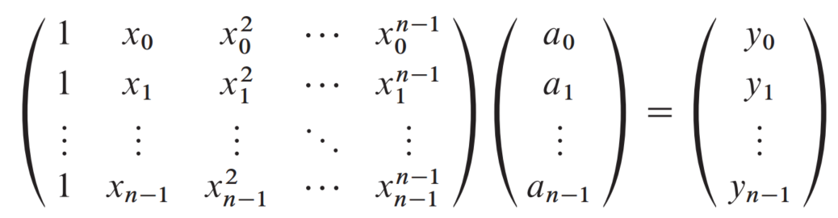
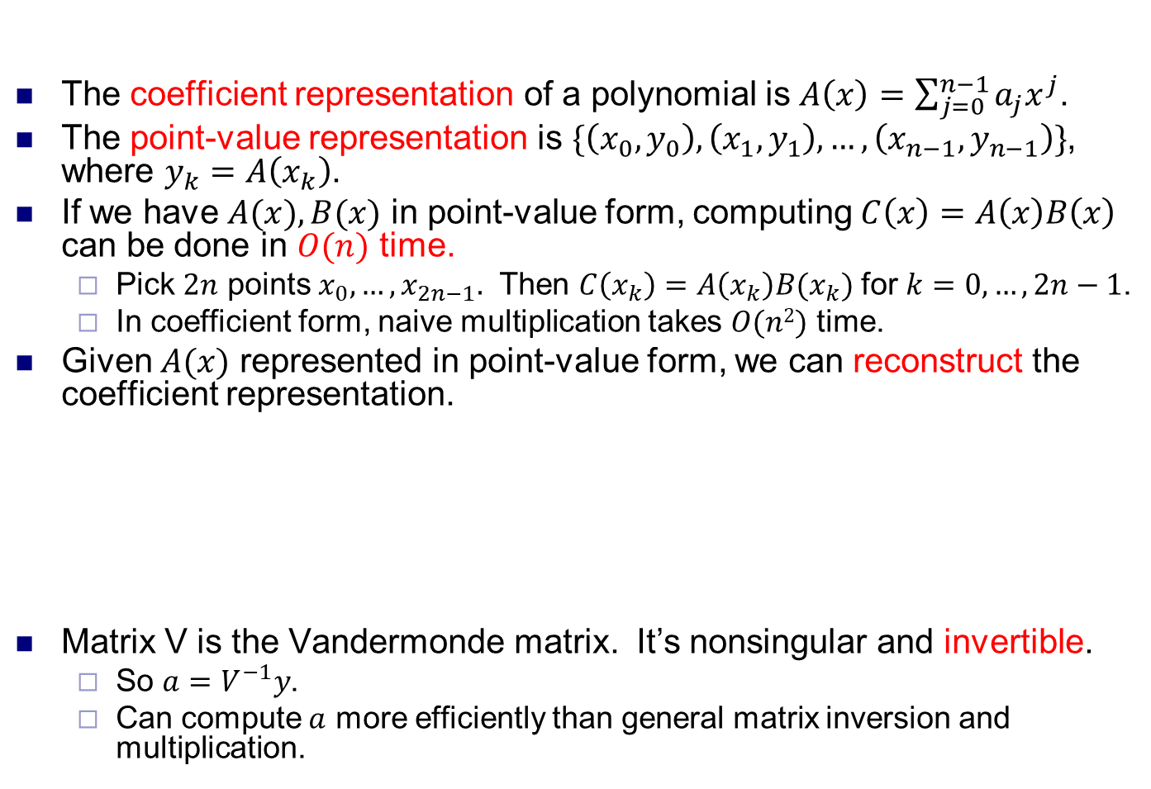
Polynomial representations
The coefficient representation of a polynomial is $A\left(x\right)=\sum_{j=0}^{n−1}{a_{j}x^{j}}$.
The point-value representation is $\{\left(x_{0},y_{0}\right), \left(x_{1},y_{1}\right),…,\left(x_{n−1},y_{n−1}\right)\}$, where $y_{k}=A\left(x_{k}\right)$.
If we have $A(x),B(x)$ in point-value form, computing $C\left(x\right)=A\left(x\right)B\left(x\right)$ can be done in $O(n)$ time.
Pick $2n$ points $x_{0},…,x_{2n−1}.$ Then $C\left(x_{k}\right)=A\left(x_{k}\right)B(x_{k})$ for $k=0,…,2n−1$.
In coefficient form, naive multiplication takes $O(n2)$ time.
Given $A(x)$ represented in point-value form, we can reconstruct the coefficient representation.
Matrix V is the Vandermonde matrix. It’s nonsingular and invertible.
So $a=V^{−1}y$.
Can compute $a$ more efficiently than general matrix inversion and multiplication.

Slide 4
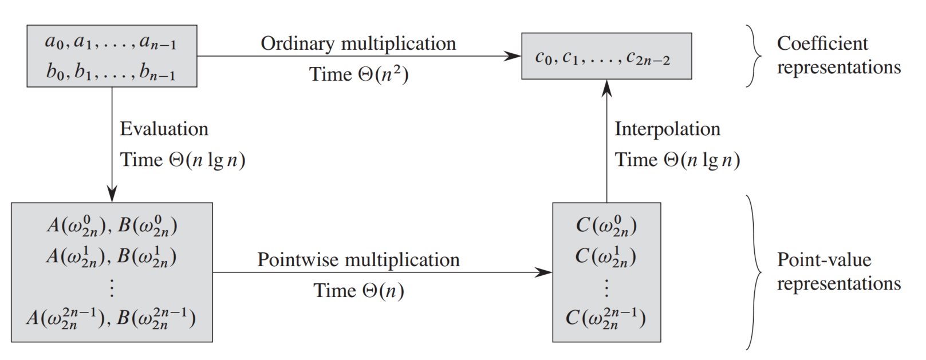
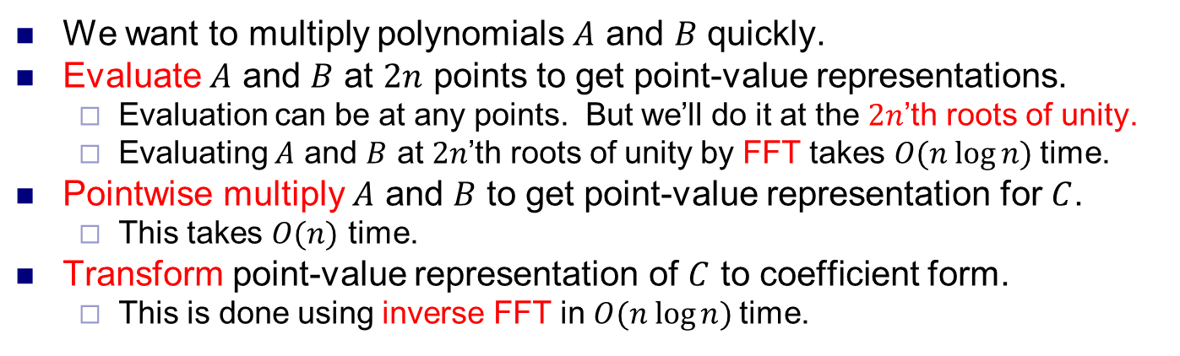
Fast polynomial multiplication
Source: Introduction to Algorithms, Cormen et al
We want to multiply polynomials $A$ and $B$ quickly.
Evaluate $A$ and $B$ at $2n$ points to get point-value representations.
Evaluation can be at any points. But we’ll do it at the $2n$’th roots of unity.
Evaluating $A$ and $B$ at $2n$’th roots of unity by FFT takes $O(n log⁡n)$time.
Pointwise multiply $A$ and $B$ to get point-value representation for $C$.
This takes $O(n)$ time.
Transform point-value representation of $C$ to coefficient form.
This is done using inverse FFT in $O(n log⁡n)$time.

Slide 5
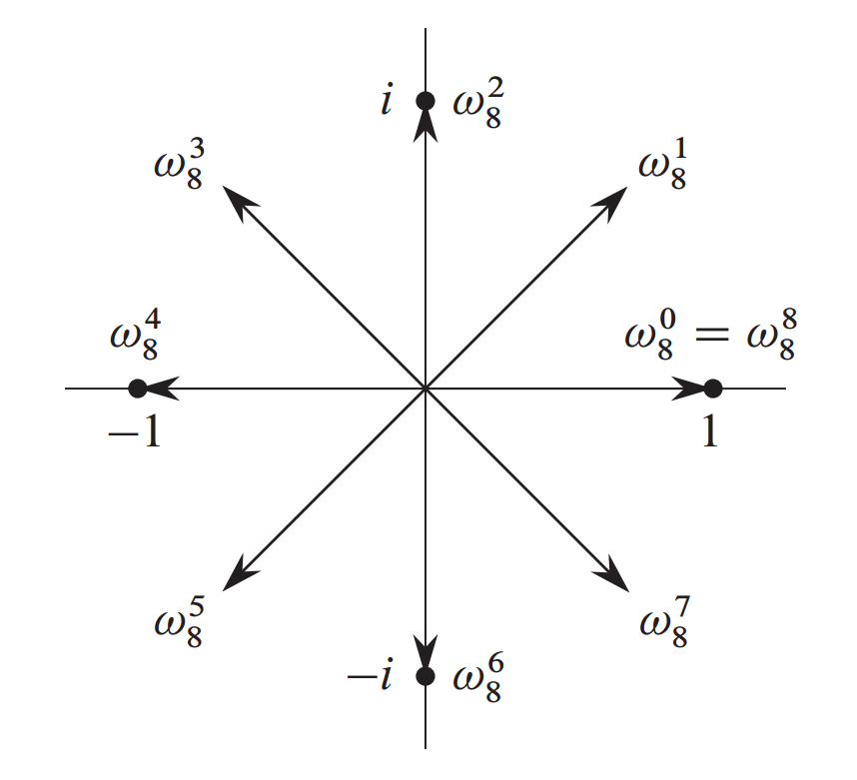
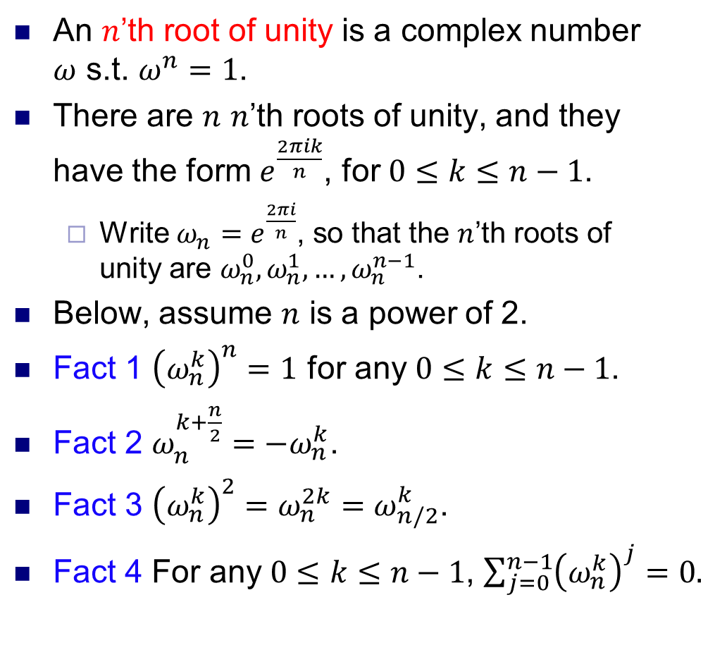
Roots of unity
An $n$’th root of unity is a complex number $ω$ s.t. $ω^{n}=1$.
There are $n$ $n$’th roots of unity, and they have the form $e^{\frac{2πik}{n}}$, for $0≤k≤n−1$.
Write $ω_{n}=e^{\frac{2πi}{n}}$, so that the $n$’th roots of unity are $ω_{n}^{0}, ω_{n}^{1}, …, ω_{n}^{n−1}$.
Below, assume $n$ is a power of 2.
Fact 1 ${\left(ω_{n}^{k}\right)}^{n}=1$ for any $0≤k≤n−1$.
Fact 2 $ω_{n}^{k+\frac{n}{2}}=−ω_{n}^{k}$.
Fact 3 ${\left(ω_{n}^{k}\right)}^{2}=ω_{n}^{2k}=ω_{n/2}^{k}$.
Fact 4 For any$0≤k≤n−1$, $\sum_{j=0}^{n−1}{{\left(ω_{n}^{k}\right)}^{j}}=0.$

Slide 6
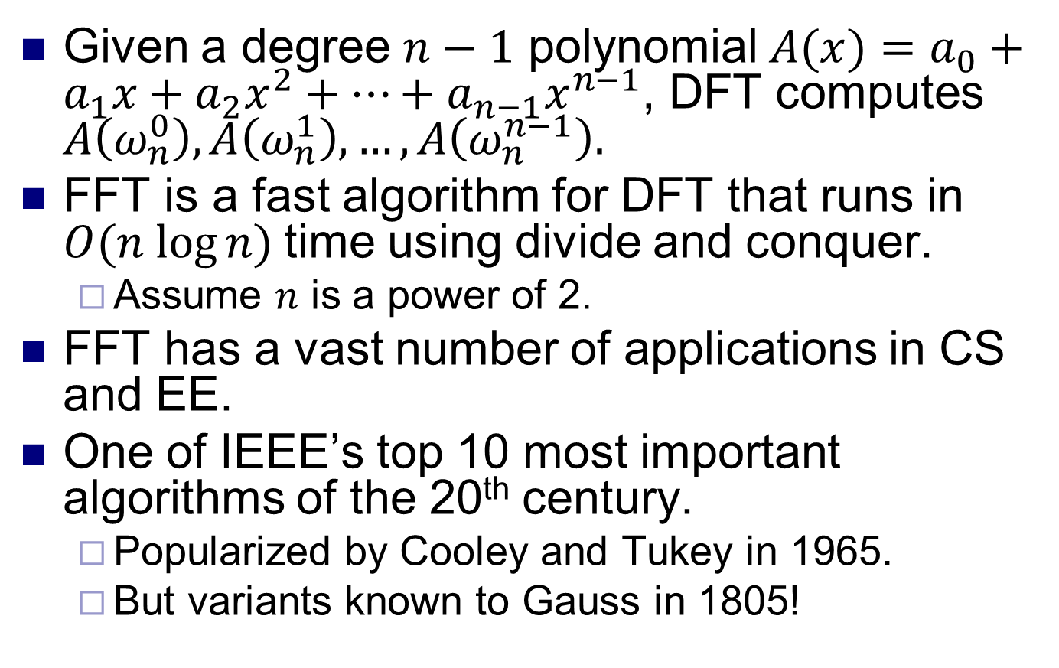
Discrete Fourier Transform
Given a degree $n−1$ polynomial $A(x)=a_{0}+a_{1}x+a_{2}x^{2}+…+a_{n−1}x^{n−1}$, DFT computes $A\left(ω_{n}^{0}\right), A\left(ω_{n}^{1}\right), …, A\left(ω_{n}^{n−1}\right).$
FFT is a fast algorithm for DFT that runs in $O(n log⁡n)$time using divide and conquer.
Assume $n$ is a power of 2.
FFT has a vast number of applications in CS and EE.
One of IEEE’s top 10 most important algorithms of the 20th century.
Popularized by Cooley and Tukey in 1965.
But variants known to Gauss in 1805!

Slide 7
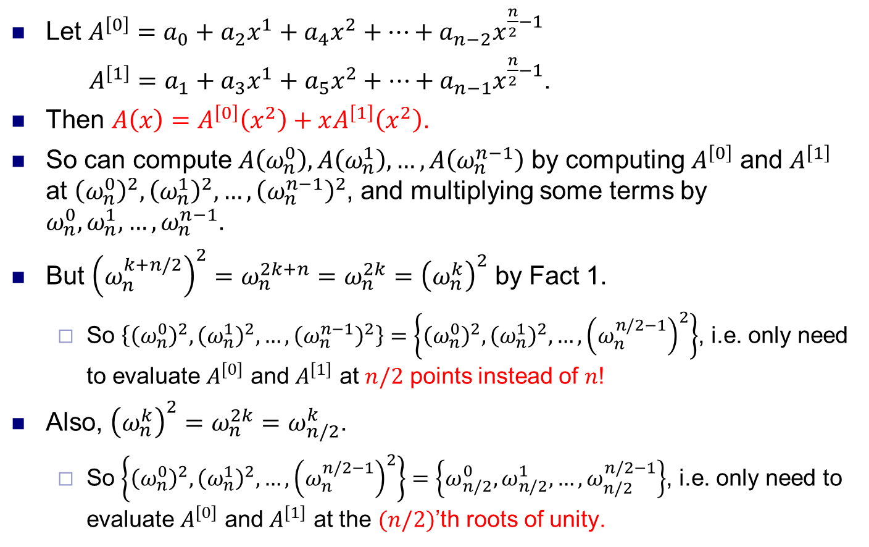
Fast Fourier Transform
Let $A^{\left[0\right]}=a_{0}+a_{2}x^{1}+a_{4}x^{2}+…+a_{n−2}x^{\frac{n}{2}−1}$
$A^{\left[1\right]}=a_{1}+a_{3}x^{1}+a_{5}x^{2}+…+a_{n−1}x^{\frac{n}{2}−1}$.
Then $A\left(x\right)=A^{\left[0\right]}\left(x^{2}\right)+xA^{\left[1\right]}\left(x^{2}\right)$.
So can compute $A\left(ω_{n}^{0}\right), A\left(ω_{n}^{1}\right), …, A\left(ω_{n}^{n−1}\right)$ by computing $A^{\left[0\right]}$ and $A^{\left[1\right]}$ at ${\left(ω_{n}^{0}\right)}^{2}, {\left(ω_{n}^{1}\right)}^{2}, …, {\left(ω_{n}^{n−1}\right)}^{2}$, and multiplying some terms by $ω_{n}^{0}, ω_{n}^{1}, …, ω_{n}^{n−1}$.
But ${\left(ω_{n}^{k+n/2}\right)}^{2}=ω_{n}^{2k+n}=ω_{n}^{2k}={\left(ω_{n}^{k}\right)}^{2}$ by Fact 1.
So $\left\{{\left(ω_{n}^{0}\right)}^{2}, {\left(ω_{n}^{1}\right)}^{2}, …, {\left(ω_{n}^{n−1}\right)}^{2}\right\}=\left\{{\left(ω_{n}^{0}\right)}^{2}, {\left(ω_{n}^{1}\right)}^{2}, …, {\left(ω_{n}^{n/2−1}\right)}^{2}\right\}$, i.e. only need to evaluate $A^{\left[0\right]}$ and $A^{\left[1\right]}$ at $n/2$ points instead of $n$!
Also, ${\left(ω_{n}^{k}\right)}^{2}=ω_{n}^{2k}=ω_{n/2}^{k}$.
So $\left\{{\left(ω_{n}^{0}\right)}^{2}, {\left(ω_{n}^{1}\right)}^{2}, …, {\left(ω_{n}^{n/2−1}\right)}^{2}\right\}=\left\{ω_{n/2}^{0}, ω_{n/2}^{1},…, ω_{n/2}^{n/2−1}\right\}$, i.e. only need to evaluate $A^{\left[0\right]}$ and $A^{\left[1\right]}$ at the $(n/2)$’th roots of unity.

Slide 8
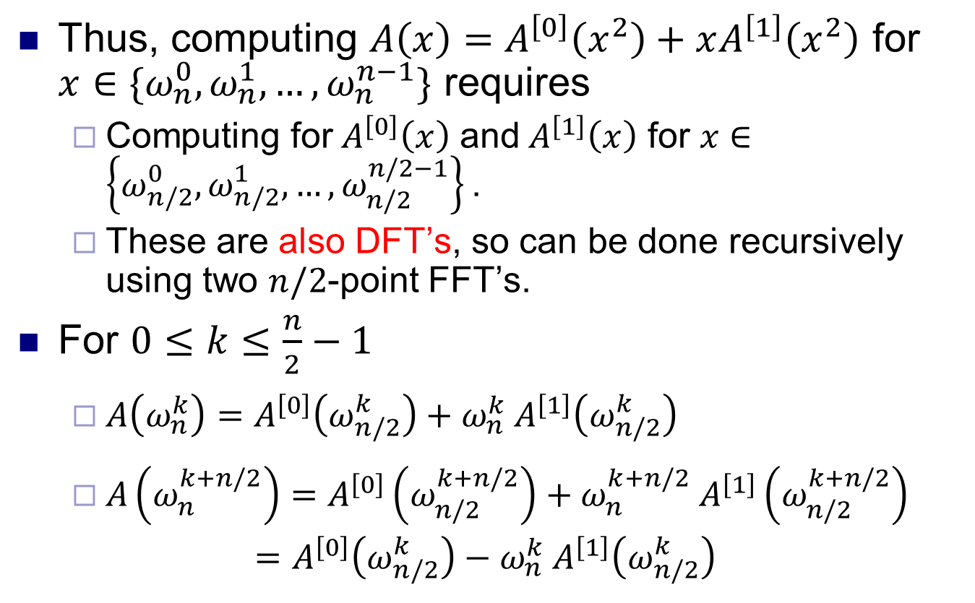
Fast Fourier Transform
Thus, computing $A\left(x\right)=A^{\left[0\right]}\left(x^{2}\right)+xA^{\left[1\right]}\left(x^{2}\right)$ for $x∈\{ω_{n}^{0}, ω_{n}^{1}, …, ω_{n}^{n−1}\text{\}}$ requires
Computing for${ A}^{\left[0\right]}\left(x\right)$ and${ A}^{\left[1\right]}\left(x\right)$ for $x∈\left\{ω_{n/2}^{0}, ω_{n/2}^{1},…, ω_{n/2}^{n/2−1}\right\}\text{.}$
These are also DFT’s, so can be done recursively using two $n/2$-point FFT’s.
For $0≤k≤\frac{n}{2}−1$
$A\left(ω_{n}^{k}\right)=A^{\left[0\right]}\left(ω_{n/2}^{k}\right)+ω_{n}^{k} A^{\left[1\right]}\left(ω_{n/2}^{k}\right)$
$A\left(ω_{n}^{k+n/2}\right)=A^{\left[0\right]}\left(ω_{n/2}^{k+n/2}\right)+ω_{n}^{k+n/2} A^{\left[1\right]}\left(ω_{n/2}^{k+n/2}\right)$
$$=A^{\left[0\right]}\left(ω_{n/2}^{k}\right)−ω_{n}^{k} A^{\left[1\right]}\left(ω_{n/2}^{k}\right)$$

Slide 9
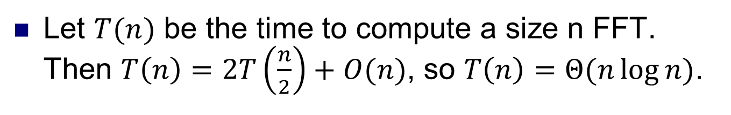
FFT algorithm
FFT(n, a₀,a₁,…,a_{n-1}) {
if (n == 1) return a₀
(e₀,e₁,…,e_{n/2-1}) ← FFT(n/2, a₀,a₂,a₄,…,a_{n-2})
(d₀,d₁,…,d_{n/2-1}) ← FFT(n/2, a₁,a₃,a₅,…,a_{n-1})
for k = 0 to n/2 - 1 {
ω^{k} ← e^{2πik/n}
y_{k} ← e_{k} + ω^{k} d_{k}
y_{k+n/2} ← e_{k} - ω^{k} d_{k}
}
return (y₀,y₁,…,y_{n-1})
}
Let $T(n)$ be the time to compute a size n FFT. Then $T\left(n\right)=2T\left(\frac{n}{2}\right)+O(n)$, so $T\left(n\right)=Θ(n\log{n)}$.

Slide 10
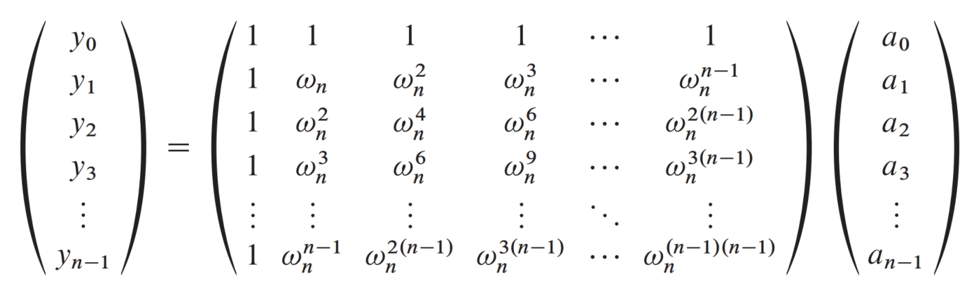
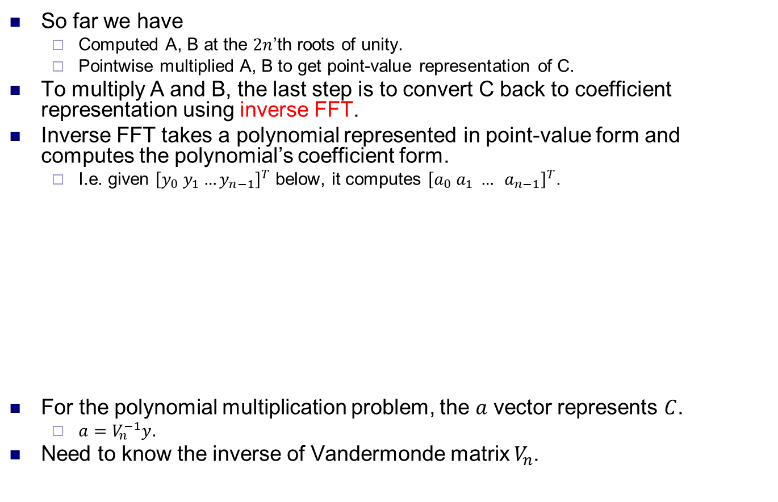
Inverse FFT
So far we have
Computed A, B at the $2n$’th roots of unity.
Pointwise multiplied A, B to get point-value representation of C.
To multiply A and B, the last step is to convert C back to coefficient representation using inverse FFT.
Inverse FFT takes a polynomial represented in point-value form and computes the polynomial’s coefficient form.
I.e. given ${\left[y_{0} y_{1}…y_{n−1}\right]}^{T}$ below, it computes ${\left[a_{0} a_{1} … a_{n−1}\right]}^{T}$.
For the polynomial multiplication problem, the $a$ vector represents $C$.
$a=V_{n}^{−1}y$.
Need to know the inverse of Vandermonde matrix $V_{n}$.

Slide 11
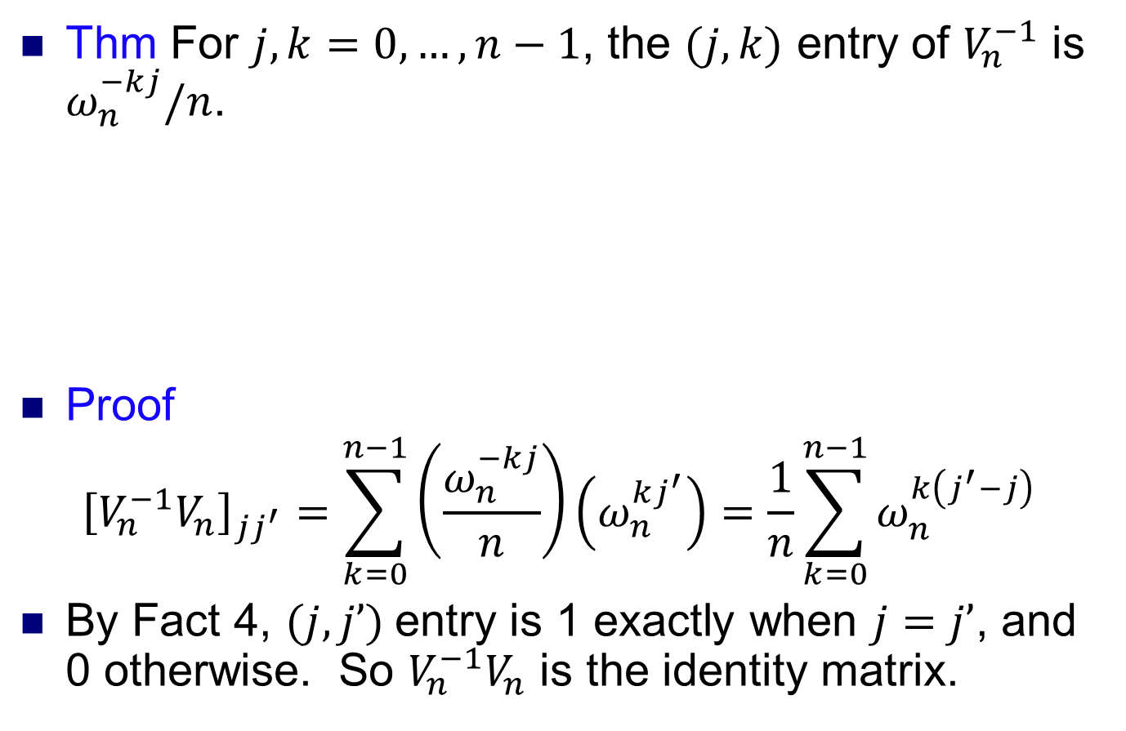
Inverse FFT
Thm For $j,k=0,…,n−1$, the $(j,k)$ entry of $V_{n}^{−1}$ is $ω_{n}^{−kj}/n$.
Proof
$${\left[V_{n}^{−1}V_{n}\right]}_{jj^{′}}=\sum_{k=0}^{n−1}{\left(\frac{ω_{n}^{−kj}}{n}\right)\left(ω_{n}^{kj^{′}}\right)=\frac{1}{n}\sum_{k=0}^{n−1}{ω_{n}^{k\left(j^{′}−j\right)}}}$$
By Fact 4, $(j,j’)$entry is 1 exactly when $j=j’$, and 0 otherwise. So $V_{n}^{−1}V_{n}$ is the identity matrix.

Slide 12
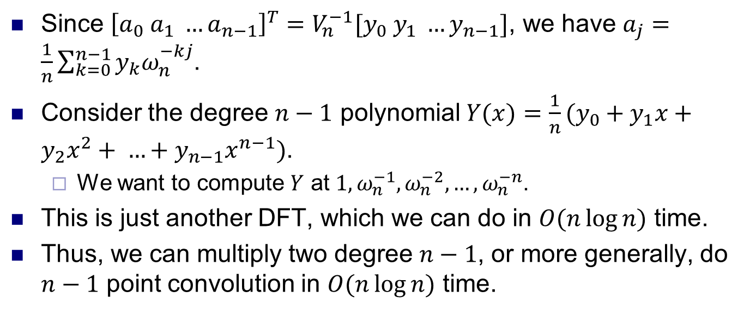
Inverse FFT
Since ${\left[a_{0} a_{1} …a_{n−1}\right]}^{T}=V_{n}^{−1}[y_{0} y_{1} …y_{n−1}]$, we have $a_{j}=\frac{1}{n}\sum_{k=0}^{n−1}{y_{k}ω_{n}^{−kj}}$.
Consider the degree $n−1$ polynomial $Y(x)={\frac{1}{n}(y}_{0}+y_{1}x+y_{2}x^{2}+ …+y_{n−1}x^{n−1})$.
We want to compute $Y$ at $1, ω_{n}^{−1},ω_{n}^{−2},…,ω_{n}^{−n}$.
This is just another DFT, which we can do in $O(n\log{n)}$ time.
Thus, we can multiply two degree $n−1$, or more generally, do $n−1$ point convolution in $O(n\log{n)}$ time.

Slide 13
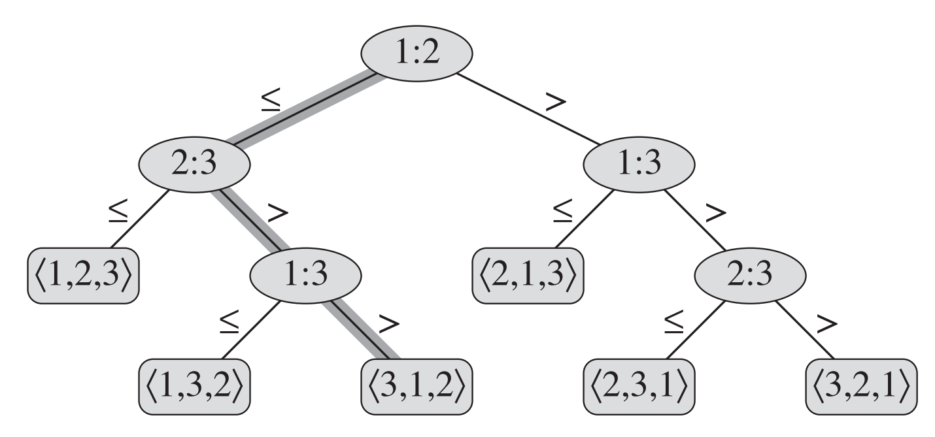
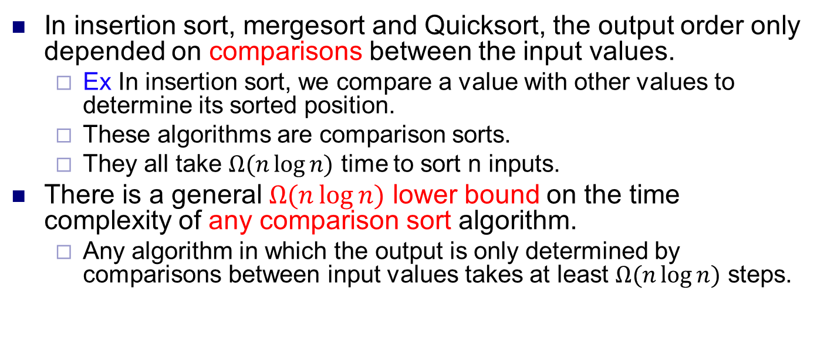
Comparison sorts
In insertion sort, mergesort and Quicksort, the output order only depended on comparisons between the input values.
Ex In insertion sort, we compare a value with other values to determine its sorted position.
These algorithms are comparison sorts.
They all take $Ω(n\log{n)}$ time to sort n inputs.
There is a general $Ω(n\log{n)}$ lower bound on the time complexity of any comparison sort algorithm.
Any algorithm in which the output is only determined by comparisons between input values takes at least $Ω(n\log{n)}$ steps.

Slide 14
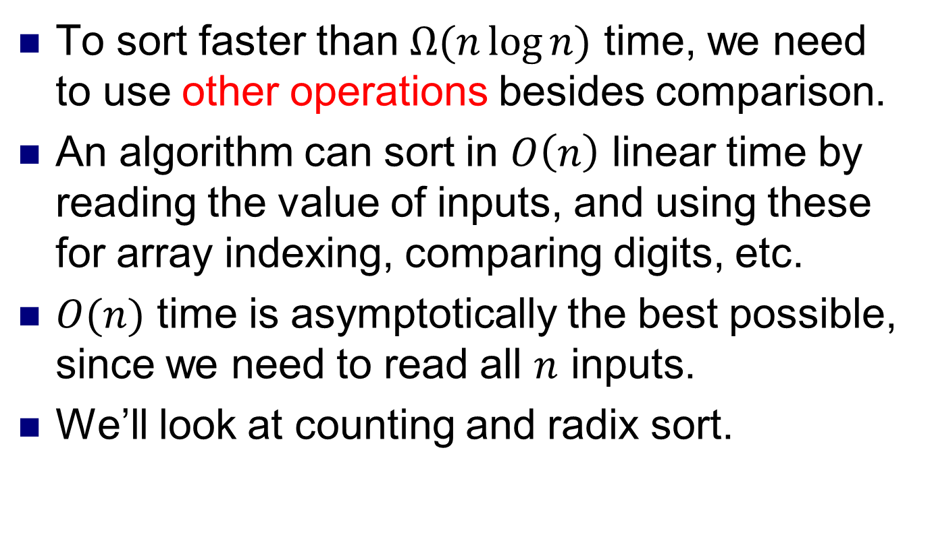
Beyond comparison sorts
To sort faster than $Ω(n\log{n)}$ time, we need to use other operations besides comparison.
An algorithm can sort in $O\left(n\right)$ linear time by reading the value of inputs, and using these for array indexing, comparing digits, etc.
$O(n)$ time is asymptotically the best possible, since we need to read all $n$ inputs.
We’ll look at counting and radix sort.

Slide 15
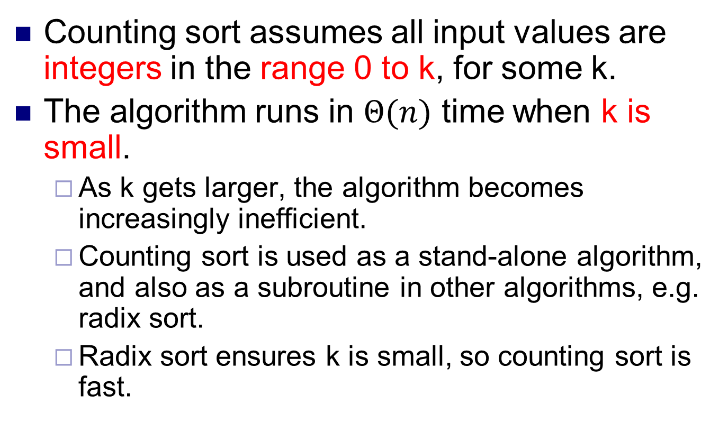
Counting sort
Counting sort assumes all input values are integers in the range 0 to k, for some k.
The algorithm runs in $Θ(n)$ time when k is small.
As k gets larger, the algorithm becomes increasingly inefficient.
Counting sort is used as a stand-alone algorithm, and also as a subroutine in other algorithms, e.g. radix sort.
Radix sort ensures k is small, so counting sort is fast.

Slide 16
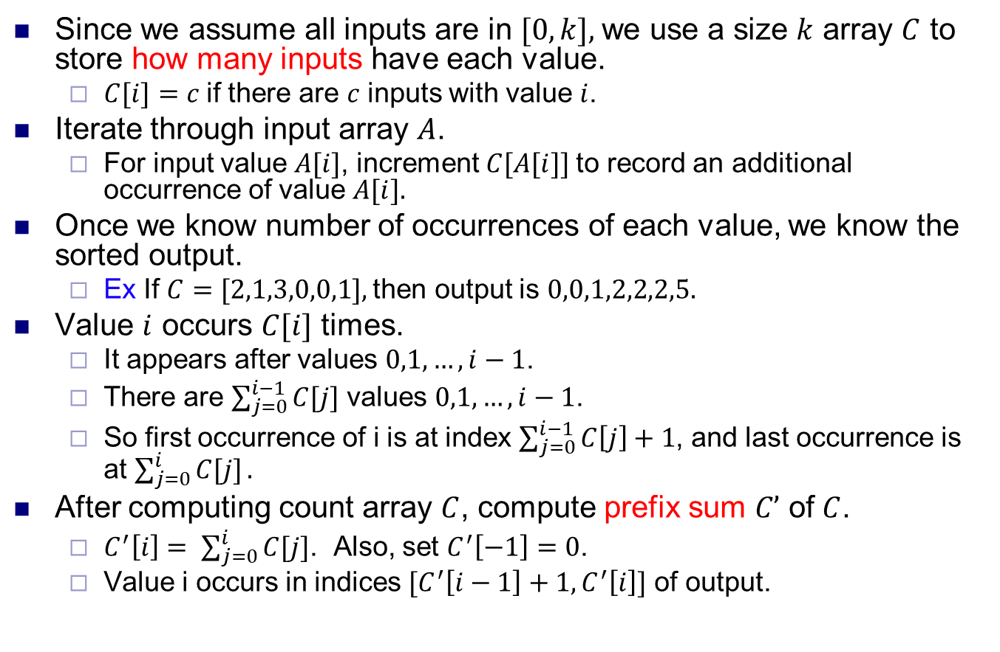
Counting sort
Since we assume all inputs are in $[0,k],$we use a size $k$ array $C$ to store how many inputs have each value.
$C[i]=c$if there are $c$ inputs with value $i$.
Iterate through input array $A$.
For input value $A[i]$, increment $C[A[i]]$to record an additional occurrence of value $A[i].$
Once we know number of occurrences of each value, we know the sorted output.
Ex If $C=[2,1,3,0,0,1],$then output is $0,0,1,2,2,2,5.$
Value $i$ occurs $C[i]$ times.
It appears after values $0,1, …,i−1$.
There are $\sum_{j=0}^{i−1}{C[j]}$ values $0,1,…,i−1$.
So first occurrence of i is at index $\sum_{j=0}^{i−1}{C\left[j\right]+1}$, and last occurrence is at $\sum_{j=0}^{i}{C[j]}.$
After computing count array $C$, compute prefix sum $C’$ of $C$.
$C^{′}\left[i\right]= \sum_{j=0}^{i}{C[j]}$. Also, set $C^{′}\left[−1\right]=0$.
Value i occurs in indices ${[C}^{′}\left[i−1\right]+1, C^{′}\left[i\right]]$ of output.

Slide 17
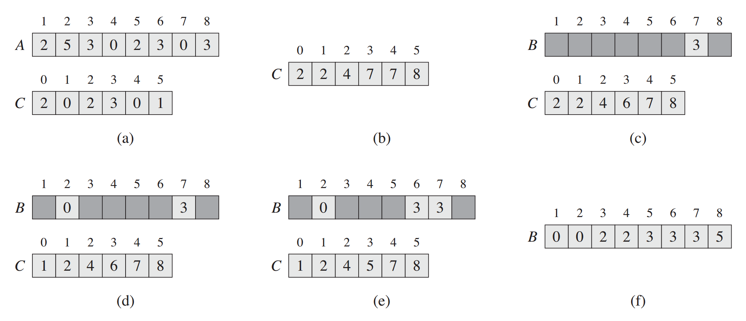
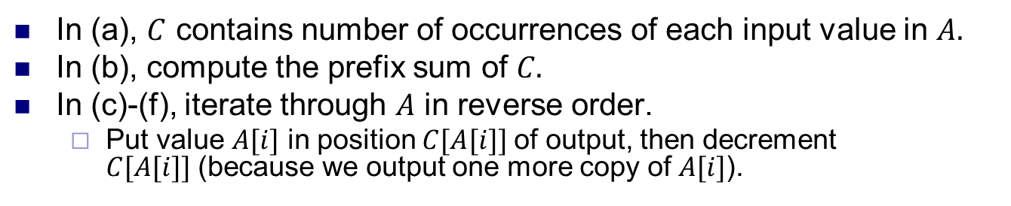
Example
Source: Introduction to Algorithms, Cormen et al.
In (a), $C$ contains number of occurrences of each input value in $A.$
In (b), compute the prefix sum of $C.$
In (c)-(f), iterate through $A$ in reverse order.
Put value $A[i]$ in position $C[A[i]]$of output, then decrement $C[A[i]]$(because we output one more copy of $A[i]$).

Slide 18
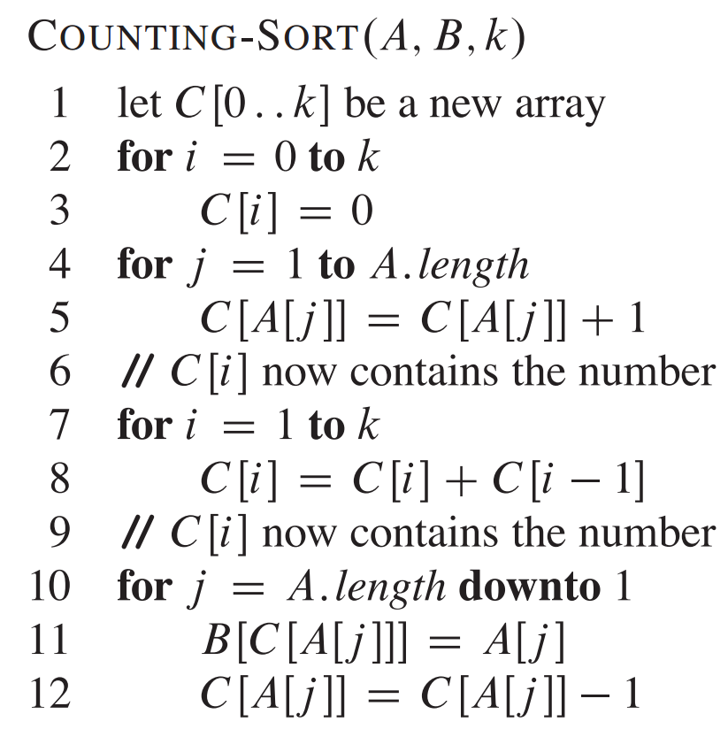
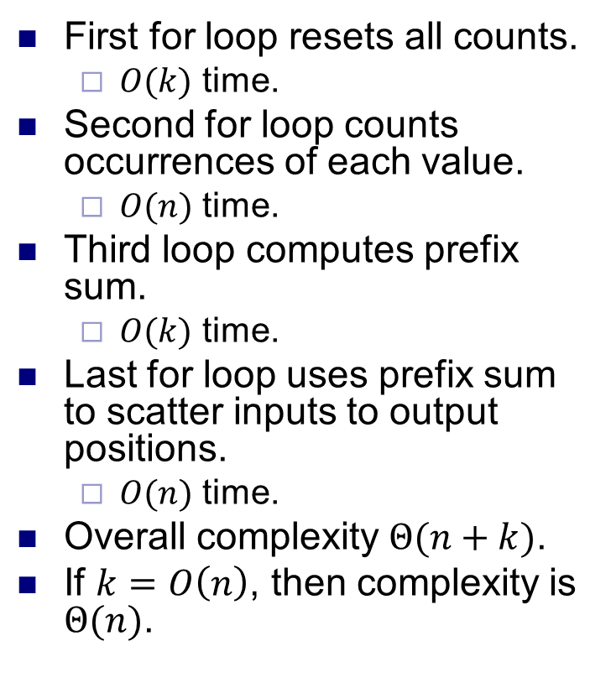
Pseudocode and complexity
First for loop resets all counts.
$O(k)$ time.
Second for loop counts occurrences of each value.
$O(n)$ time.
Third loop computes prefix sum.
$O(k)$ time.
Last for loop uses prefix sum to scatter inputs to output positions.
$O(n)$ time.
Overall complexity $Θ(n+k)$.
If $k=O\left(n\right)$, then complexity is $Θ(n)$.

Slide 19
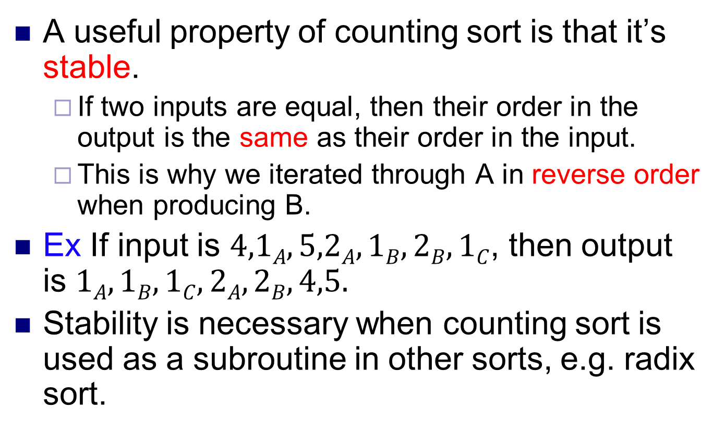
Stability
A useful property of counting sort is that it’s stable.
If two inputs are equal, then their order in the output is the same as their order in the input.
This is why we iterated through A in reverse order when producing B.
Ex If input is $4,1A,5,2A,1B,2B,1C$, then output is $1A,1B,1C,2A,2B,4,5.$
Stability is necessary when counting sort is used as a subroutine in other sorts, e.g. radix sort.

Slide 20
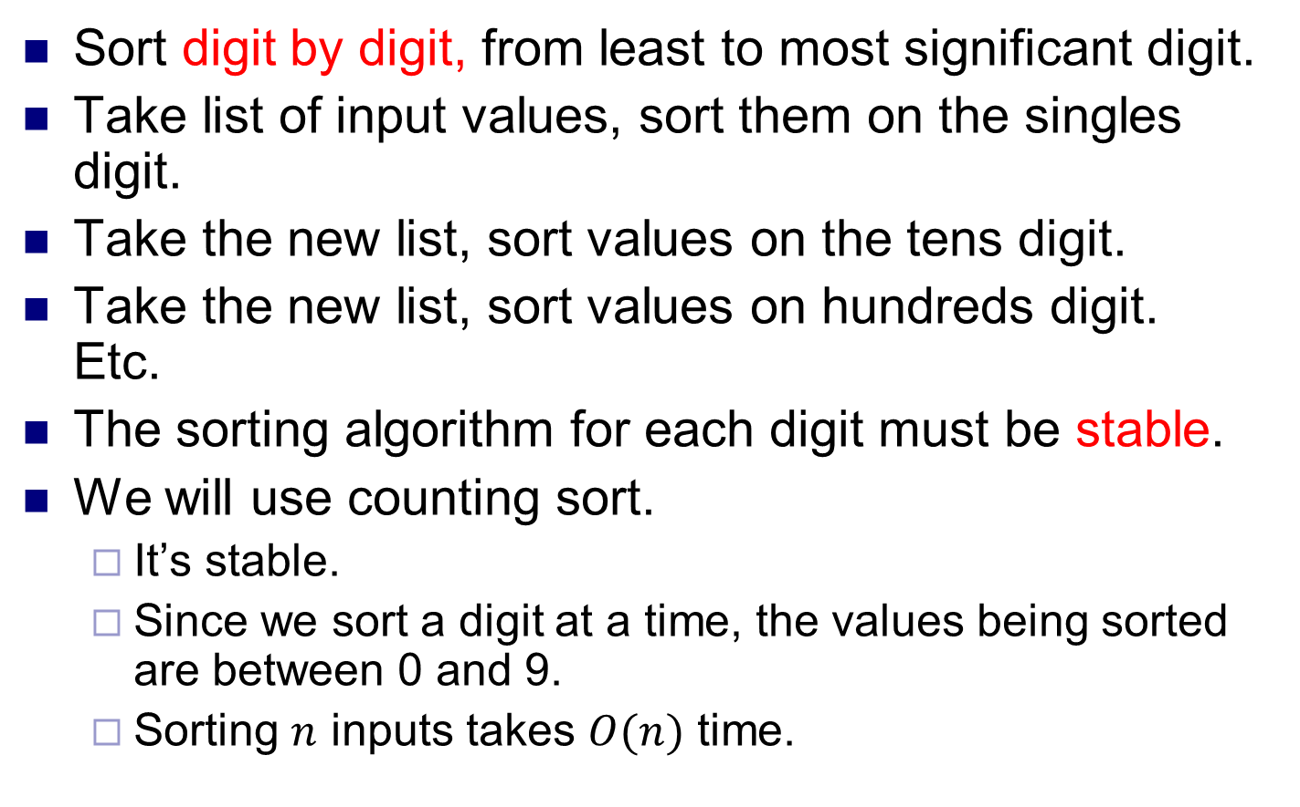
Radix sort
Sort digit by digit, from least to most significant digit.
Take list of input values, sort them on the singles digit.
Take the new list, sort values on the tens digit.
Take the new list, sort values on hundreds digit. Etc.
The sorting algorithm for each digit must be stable.
We will use counting sort.
It’s stable.
Since we sort a digit at a time, the values being sorted are between 0 and 9.
Sorting $n$ inputs takes $O(n)$ time.

Slide 21
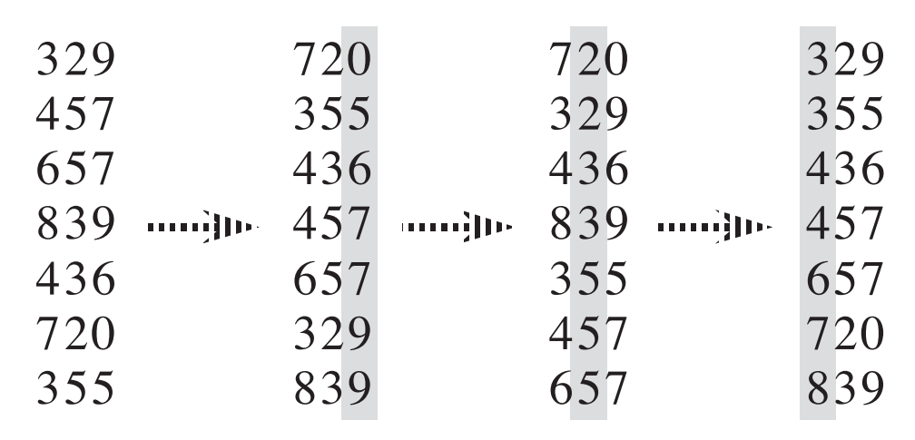
Example
Notice due to stability, after sorting by the 10’s digit, 436 and 839 (for example) keep the same order they had after sorting by the 1’s digit.

Slide 22
Correctness
Lemma 1 Let x and y be two inputs to radix sort.
Let k be the most significant digit on which they differ.
Suppose k’th digit of x is less than k’th digit of y.
After sorting the k’th digit (in nondecreasing order), x will come before y in the remainder of the execution.
Proof x comes before y right after sorting the k’th digit.
x and y are equal on all higher digits.
So when sorting on higher digits, x and y are always tied.
Since the sort is stable, x stays before y from the k’th sort onwards.

Slide 23
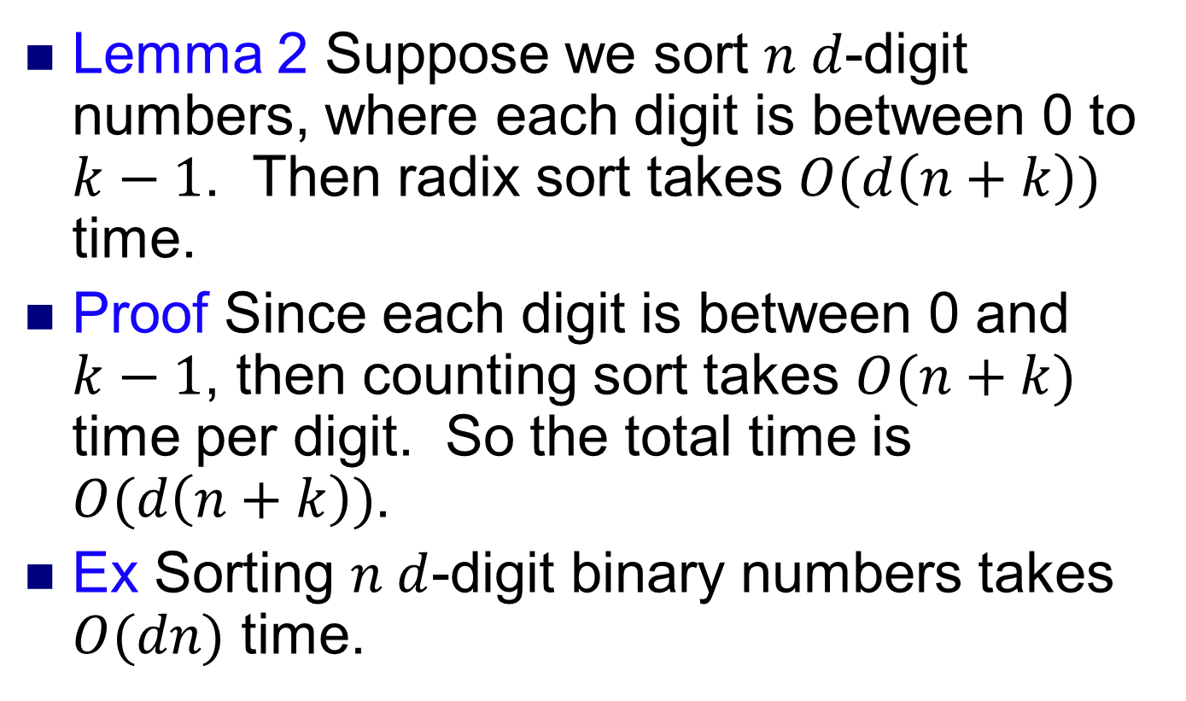
Complexity
Lemma 2 Suppose we sort $n d$-digit numbers, where each digit is between 0 to $k−1$. Then radix sort takes $O(d\left(n+k\right))$ time.
Proof Since each digit is between 0 and $k−1$, then counting sort takes $O(n+k)$ time per digit. So the total time is $O(d\left(n+k\right))$.
Ex Sorting $n d$-digit binary numbers takes $O(dn)$ time.

Slide 24
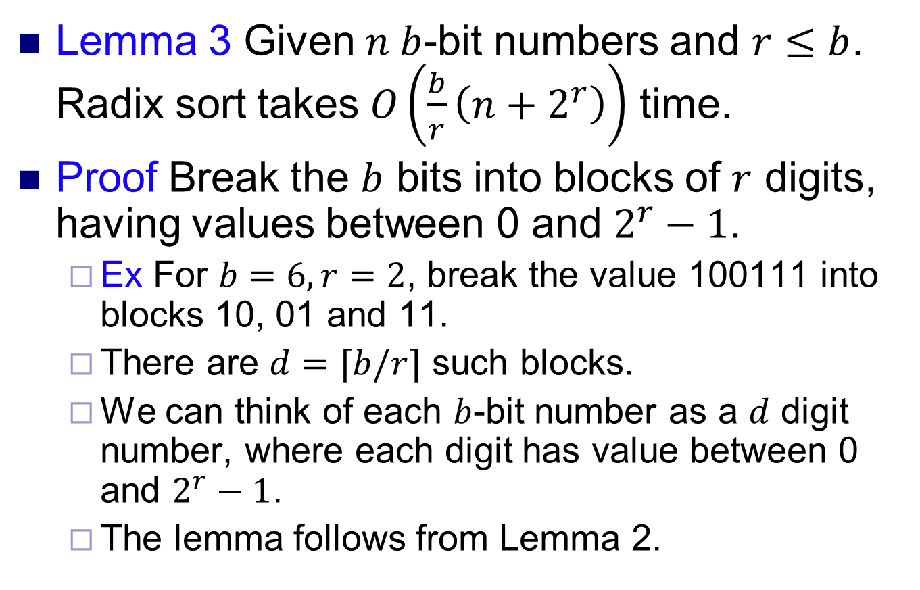
Complexity
Lemma 3 Given $n b$-bit numbers and $r≤b$. Radix sort takes $O\left(\frac{b}{r}\left(n+2^{r}\right)\right)$ time.
Proof Break the $b$ bits into blocks of $r$ digits, having values between 0 and $2^{r}−1$.
Ex For $b=6, r=2$, break the value 100111 into blocks 10, 01 and 11.
There are $d=⌈b/r⌉$ such blocks.
We can think of each $b$-bit number as a $d$ digit number, where each digit has value between 0 and $2^{r}−1$.
The lemma follows from Lemma 2.

Slide 25
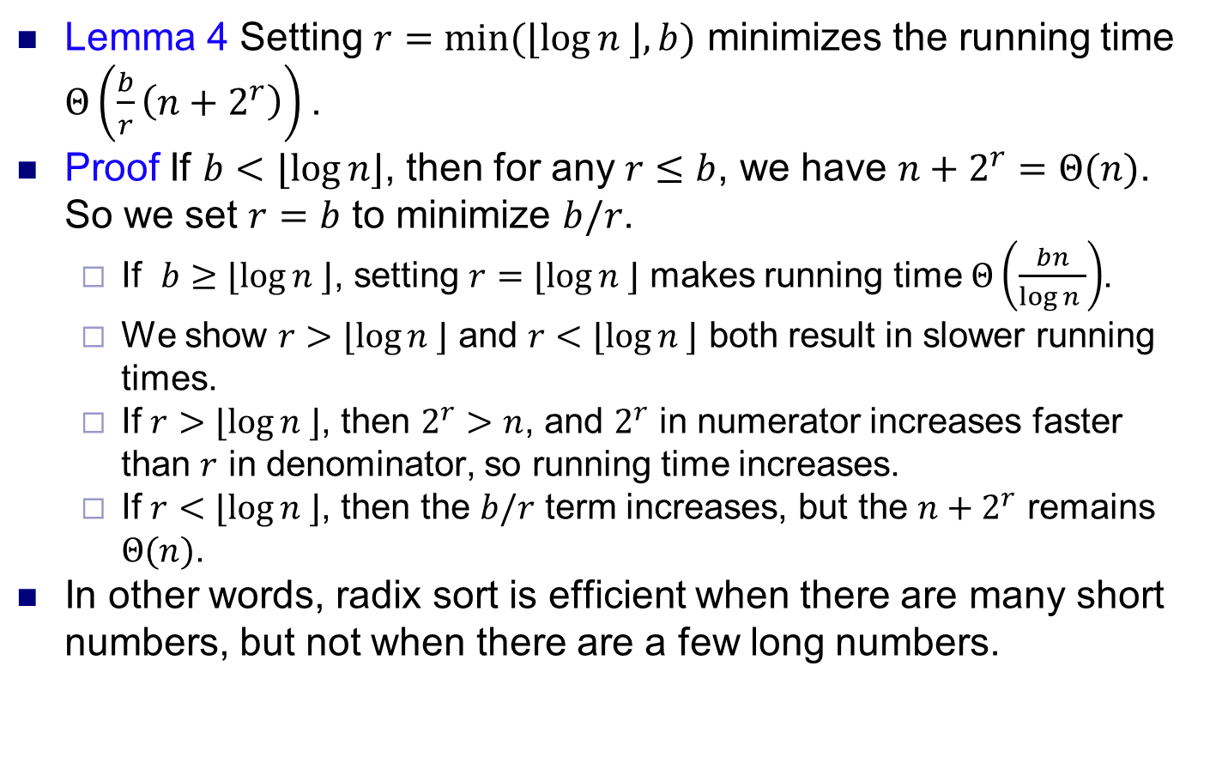
Complexity
Lemma 4 Setting $r=min⁡(⌊\log{n ⌋, b)}$ minimizes the running time $Θ\left(\frac{b}{r}\left(n+2^{r}\right)\right)$.
Proof If $b<⌊\log{n⌋}$, then for any $r≤b$, we have $n+2^{r}=Θ(n)$. So we set $r=b$ to minimize $b/r$.
If $b≥⌊\log{n ⌋}$, setting $r=⌊\log{n ⌋}$ makes running time $Θ\left(\frac{bn}{\log{n }}\right)$.
We show $r>⌊\log{n ⌋}$ and $r<⌊\log{n ⌋}$ both result in slower running times.
If $r>⌊\log{n ⌋}$, then $2^{r}>n$, and $2^{r}$ in numerator increases faster than $r$ in denominator, so running time increases.
If $r<⌊\log{n ⌋}$, then the $b/r$ term increases, but the $n+2^{r}$ remains $Θ(n)$.
In other words, radix sort is efficient when there are many short numbers, but not when there are a few long numbers.

